Slide 1
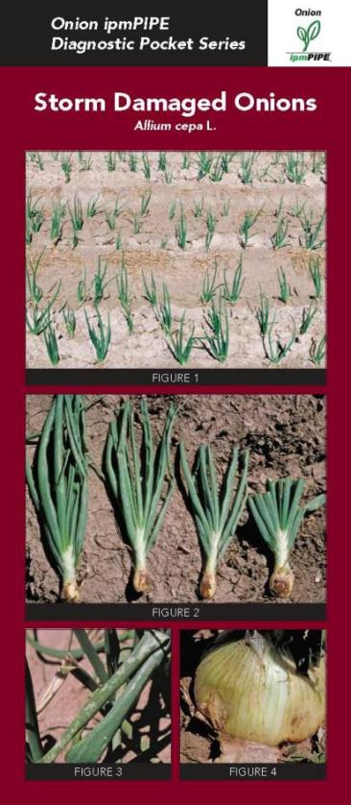
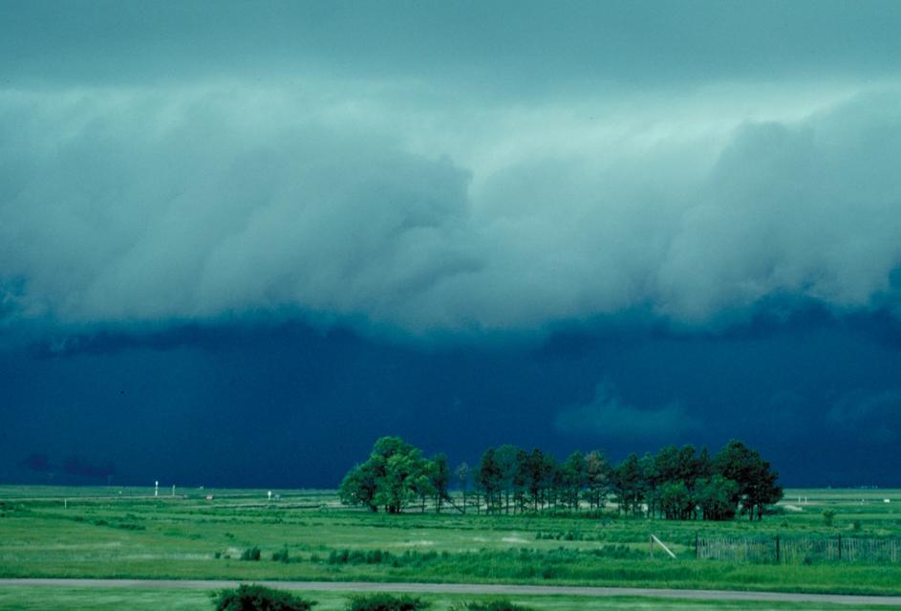
Onion - Storm Damage Summary by H. F. Schwartz, Colorado State University, 08/13

Slide 2
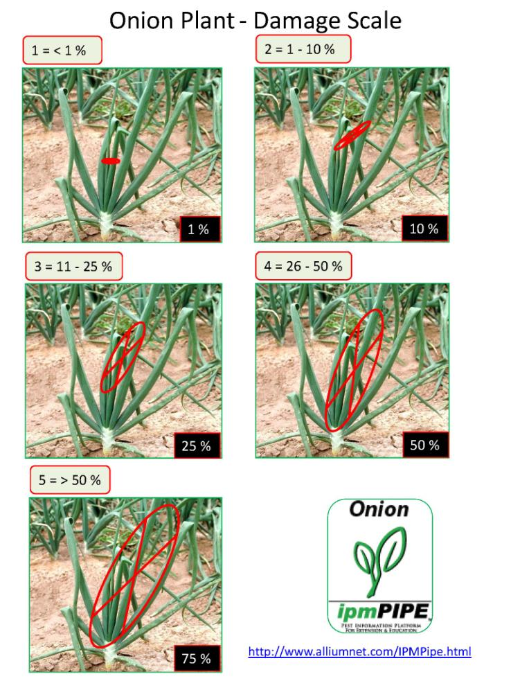
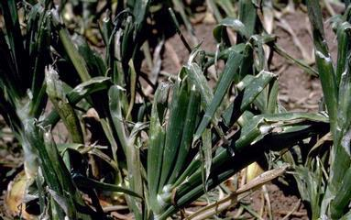
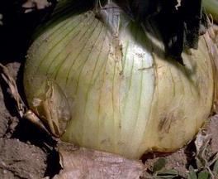
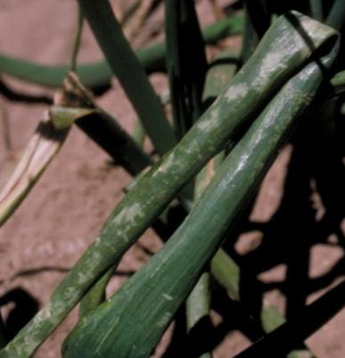
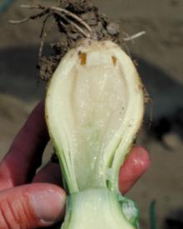
Foliage Loss
Wounds
Bruising
Disease

Slide 3
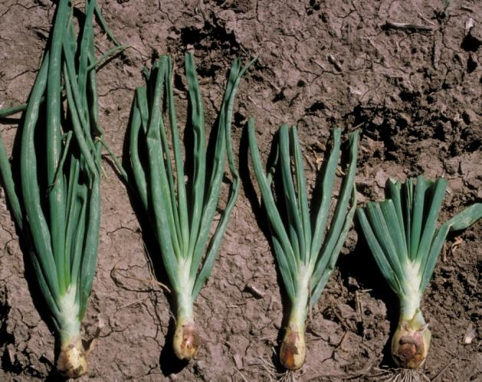
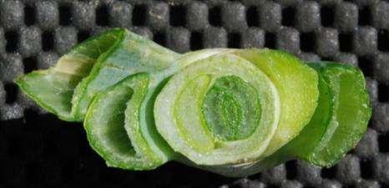
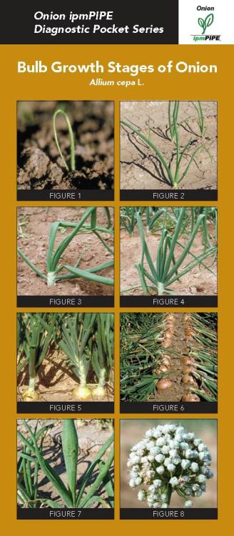
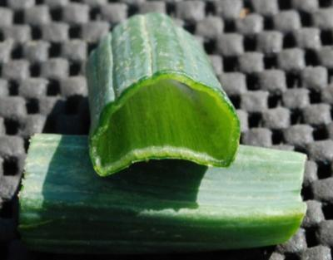
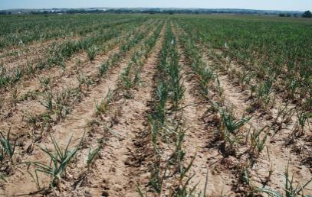
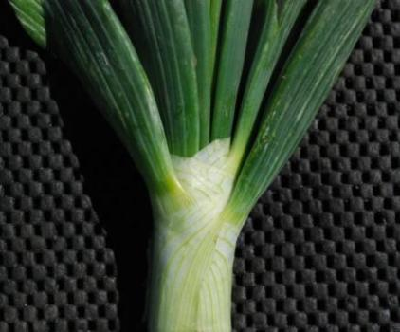
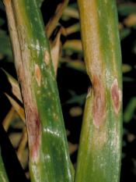
New Leaf Emergence
Foliage Recovery
Leaf Integrity
Disease
Varietal Response
Neck Integrity

Slide 4
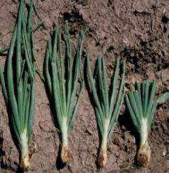
% Marketable Yield – dehydrated onions 1995-98 at Hermiston, OR / [Clough 2004 HortScience 39:1005-1007]
Yield was reduced 30% or more when defoliation was 50% or greater
Defoliation

Slide 5
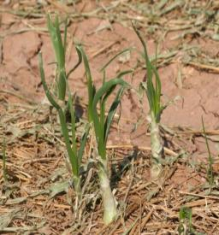
Marketable Yield - % of Undamaged Control 1991-92 at Rocky Ford, CO / [Bartolo et al. 1994 HortScience 29:1465-1467]
Defoliation
Yield was reduced 25% or more when defoliation was 67% at 4 – 8 weeks before maturity
Days Before Maturity

Slide 6
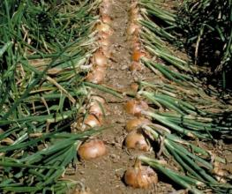
Delayed Maturity - % Tops Down 1991 at Rocky Ford, CO / [Bartolo et al. 1994 HortScience 29:1465-1467]
Defoliation
Cropping was delayed 5 to 10 days when defoliation occurred at 4 – 8 weeks before anticipated maturity
Days Before Maturity

Slide 7

Dollar Loss per acre ($260 / mt – jumbo & $220 / MT – medium) 1991-92 at Rocky Ford, CO [Bartolo et al. 1994 HortScience 29:1465-1467]
Defoliation
Economic losses were $500 to $2000 per acre when defoliation occurred 4 – 8 weeks before maturity
Days Before Maturity

Slide 8
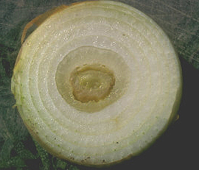
Post-Storm Damage Responses - Consider the Following:
Yield loss will reflect the timing / severity of damage from wind, rain, hail
Mechanical wounds during storm can be infected by plant pathogens
Excess water from runoff, rain, dew, fog favors pathogen spread and infection
Do NOT apply nitrogen post-bulb or post-damage
Copper-based bactericides may reduce, but not prevent, secondary spread by bacterial pathogens
Follow good topping, curing, storage practices

